Slide 1
Torque Transfer
Shashank Hegde
Tushar Kumar
Sriram Ramaswamy
Sumeet Bachani

Slide 2
Introduction
The goal of our project is to demonstrate how Transfer Learning can be used across simulators and eventually in a real life environment.
The process of learning knowledge is done by using Reinforcement Learning (RL). For our project, Proximal Policy Optimization (PPO) is preferred as our RL algorithm as it outperforms many other RL algorithms on most continuous control environments.

Slide 3
Progress
Trained PPO for TORCS.
Trained PPO for Donkey Car Simulator
Setting up of the Reinforcement Learning environment for Udacity Self Driving Car Simulator. (Deep Learning Environment has been setup).
Framework and code structures are live, Accomplished training for two of the simulators.

Slide 4
State Representation Learning (Approach 1)
We train a Variational Autoencoder to compress the image to a lower dimensional space. This way we extract the major features as there is a bottleneck present. (approach was released by Waywe.ai and bettered by Antonin Raffin)
This is called as State Representation Learning and the Reinforcement Learning algorithm learns the control policy using the VAE features as input. (used only for Donkey car)
PPO
Observation
VAE
Action

Slide 5
Curriculum Learning (Approach 2)
Employed to handle time constraints
Agent learns on simple tasks and then moves on to more complicated ones
Eg. Torcs: Learn straight roads, move on to short tracks with turns, then to complete, large tracks.

Slide 6
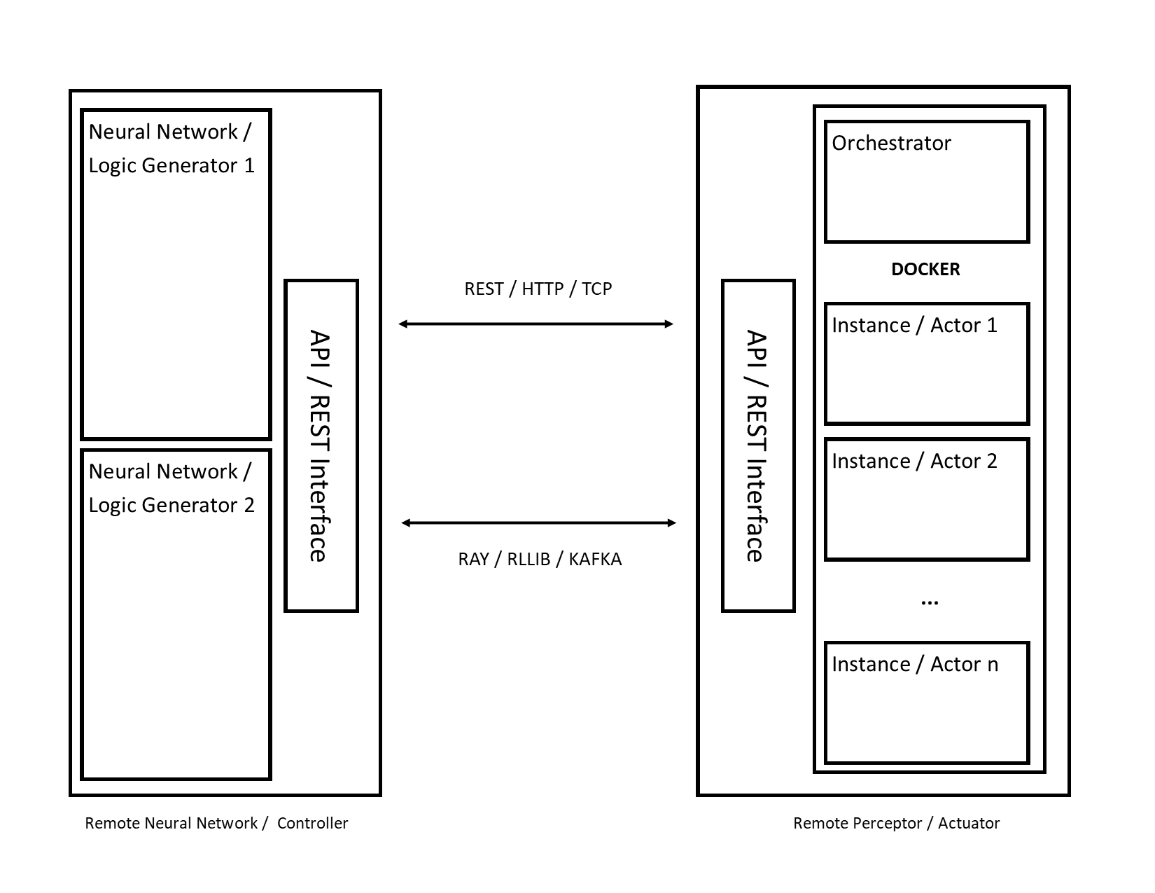
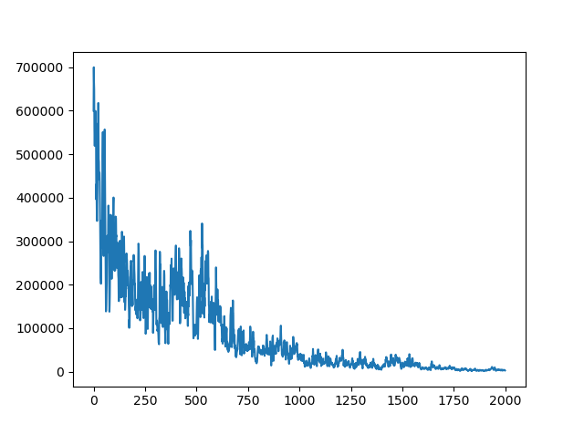
Distributed Architecture
De-linking controller and actuator
Multi-controller support
Platform Agnosticity
Easy scalability
Acts as a “boilerplate” with environments and controllers easily configurable
Virtual Screen support for image-based processing on headless clusters
Simple 3x3 Treasure Seeker training loss on a 8-docker distributed system trained by a DQN using Monte Carlo simulations

Slide 7
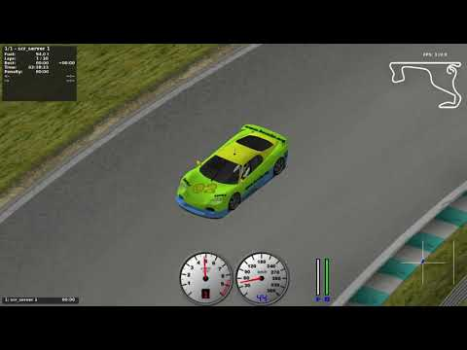
DEMO TORCS -1

Slide 8
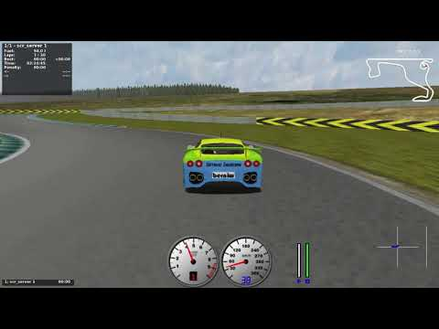
DEMO TORCS - 2

Slide 9
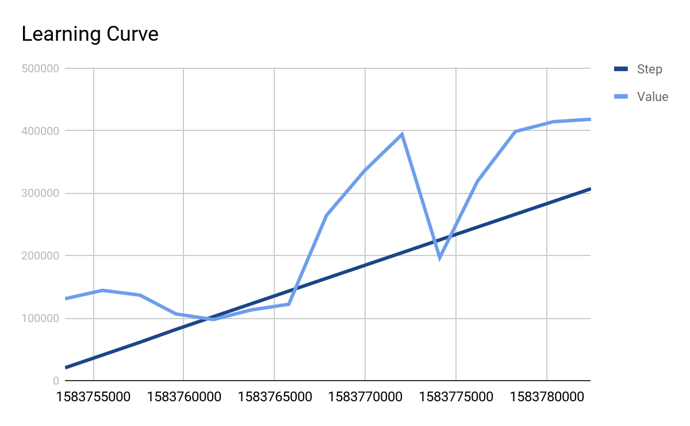

Slide 10
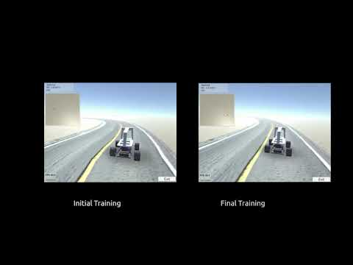
DEMO Donkey Car Sim - 1

Slide 11

DEMO Donkey Car Sim - 2 (Transfer Learning)

Slide 12
Time-Line
18/Feb
3/March
17/March
31/March
14/April
EDD Ready
TORCS RL complete
Donkey car and Udacity car sim RL complete
Test on Udacity Car Sim
Transfer learning from TORCS to Donkey Car Sim
Implement RL for TORCS and Donkey Car Sim
Complete the Engineering Design Document
Implement PPO TORCS and obtain learning curves
Compare the learning curve with the agent that learnt without RL
Test the RL agent on an unseen Udacity Car Sim

Slide 13
What Next?
Taking larger image as input for our policy network as compared to sensor data/smaller image
Transfer Learning of the agent which learned driving on TORCS to Donkey Car Simulator
Transferring of the code to Dockers to run parallel environments
Pushing of the Dockers to EC2 to handle heavy computations
Using of RLlib which is an open-source library for reinforcement learning that offers both high scalability and a unified API for a variety of applications

Slide 14
Thank you

